Slide 1

Understanding & Extracting
the Latent Value in Coal
Beyond Non-coking coal to Coking Coal
Richard A. Horner
Director Special Projects and Emerging Technology
School of Energy Resources
University of Wyoming
© 2017 All rights reserved. Property of the University of Wyoming
Notes:
Thank introduction
Thank PCC for opportunity to speak
My name is
Title

Slide 2
Outline
Outlook for Coal in Inda
New markets
  Coking Coal
  Non energy and Fuel Products
Existing Technology Approaches
  FMC Coking
  Hyper-coal
  HHS technology
  Thermo-chemical processing
The Coal Refinery
  Thermo-chemical coal processing
Concluding Remarks

Slide 3
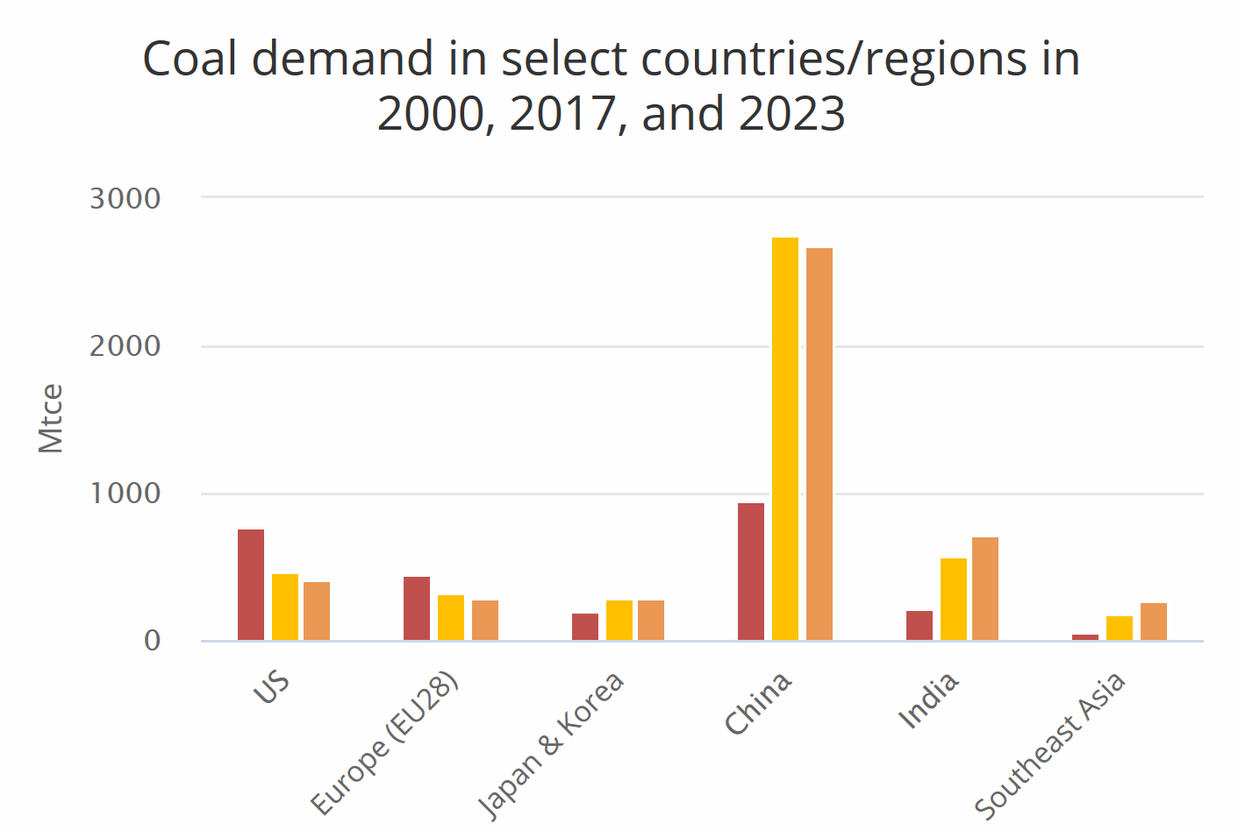
Outlook for Coal in India
Coal will grow as a most important natural resource on which its economy will prosper.
Forecasts indicate that India will become the Largest Importer of Coking Coal by 2015
  Annual growth rate of 5.4% between 2019 and 2028.
[Reference: IEA Coal 2018; Analysis andFforecasts to 2023]

Slide 4
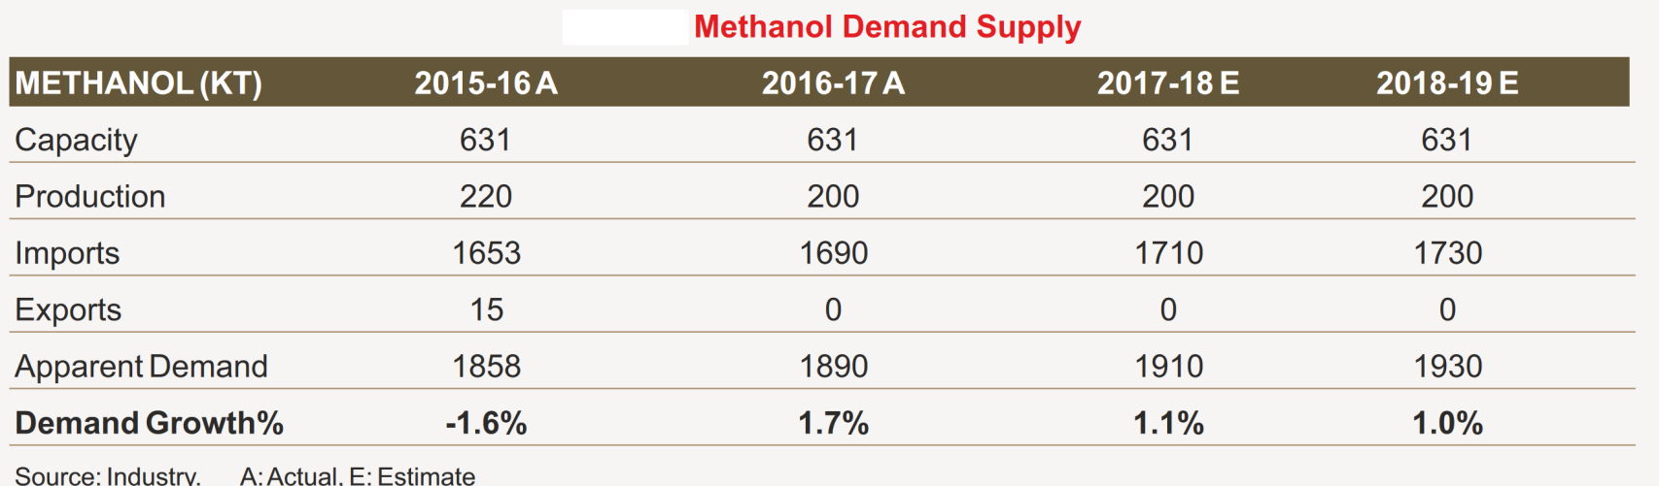
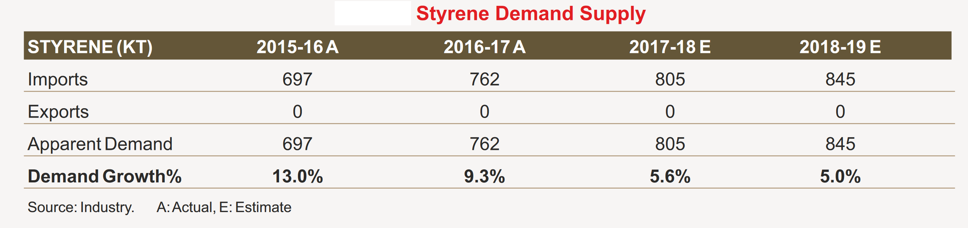
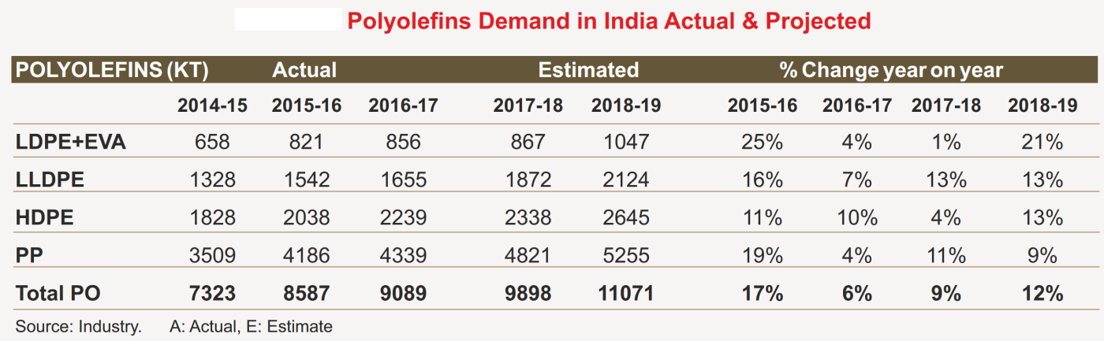
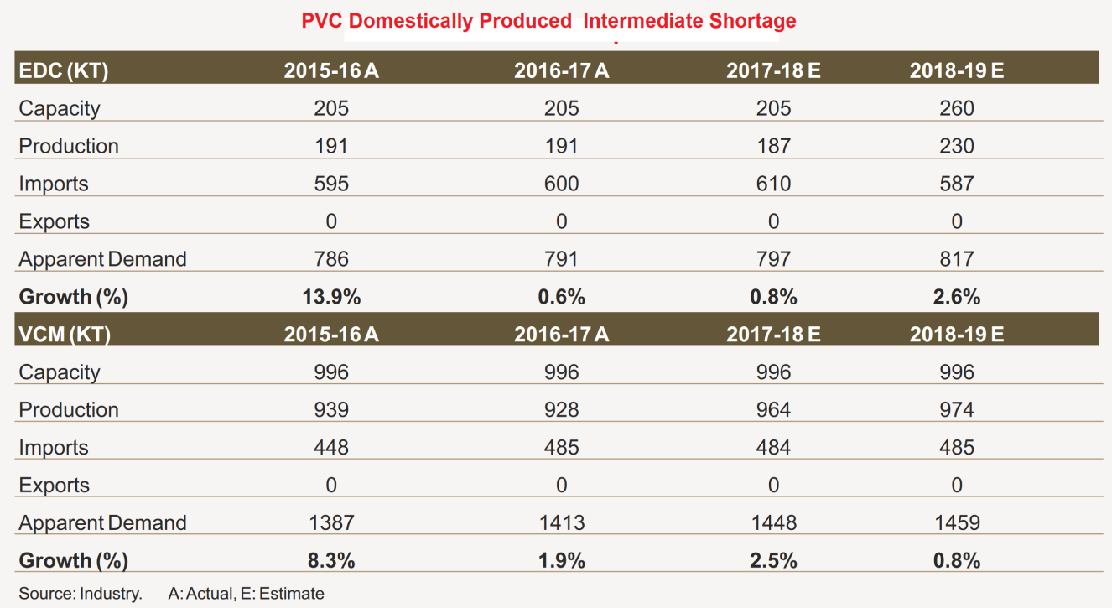
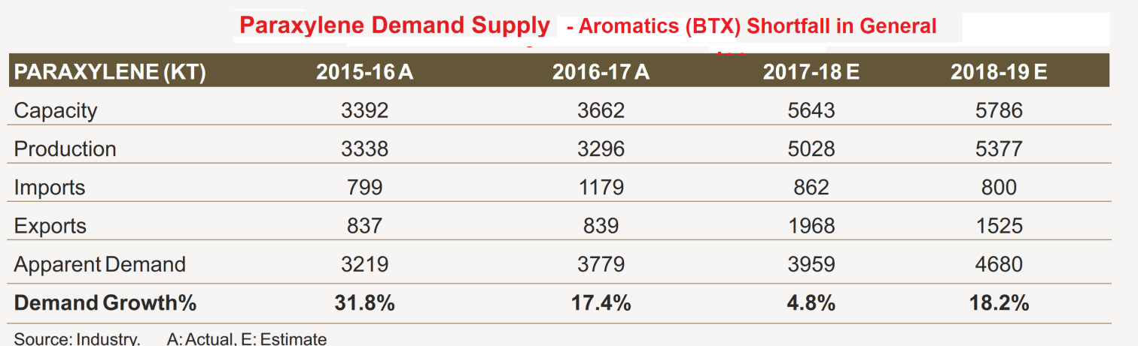
Petrochemicals are a Growth Opportunity
[Reference Asia Petrochemical Industry Conference: India Report 2018]

Slide 5
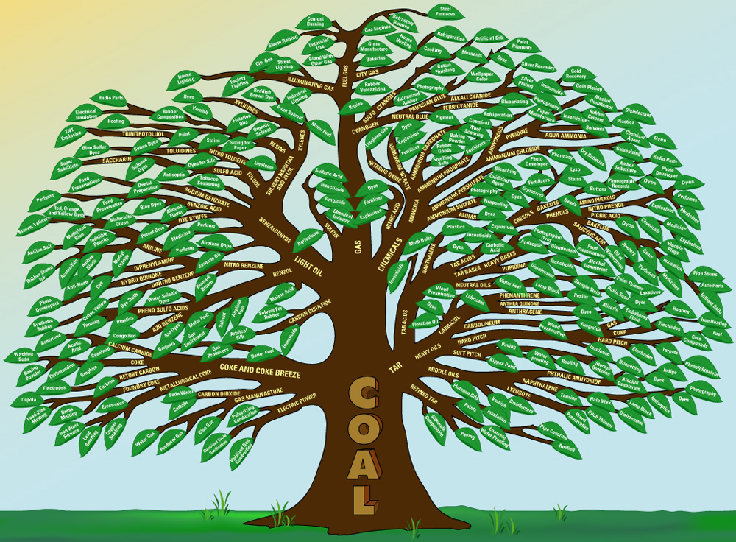

Coal to Non Energy & BTU Products
The possibilities are vast!
Some of these chemicals and materials can only economically come from coal!
Reference: US Geological Survey
© 2017 All rights reserved. Property of the University of Wyoming
Notes:
Each leaf represents a product
Were looking at products that aren’t energy
Some leaves can be made from coal but aren’t due to economics or environmental constraints
Other industries like oil can make cheaper
HOWEVER, Some of the leaves are only made from coal like cokes and creosotes
Market and technology has made some of these products possible now, economically

Slide 6
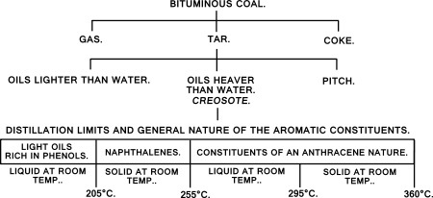
Summary of Coal Conversion…TODAY
Some specialty chemical products
today can only be derived from coal
Unlike crude oil, coal is not readily fractionable.
Coal constituent polycyclic hydrocarbons which readily react and polymerize.
We know how to destruct coal and how to break it down into smallest molecules to build it up again (gasification and XtoL)
  Hugely energy intensive
  No good for extraction of hiddeent value in coal
Understanding conversion behavior – thermal impacts on molecular chemistry is crucial to exploit coal’s ‘hidden’ value
© 2017 All rights reserved. Property of the University of Wyoming
Notes:
Coal is readily convertible but not fractionatable
We need to transform the coal before we can get valuable intermediates
Our coal is very reactive
There is a desire to understand conversion behavior
Thermodynamics
Molecular chemistry
Find hidden value of coal

Slide 7
Evaluating Coal Conversion Approaches
Two ways to convert coal to extract ‘hidden’ value
  Thermally
  Pyrolysis, gasification and liquefaction
  Chemically
  Solvent extraction (Single phase, Low temperature)
Factors determining coal conversion approaches to pursue
  Considerations
  oxygen in liquids/solids
    Somewhat unique to PRB Coal
  Using complementary feedstocks with coal (e.g. natural gas), to diversify the portfolio of products that can be manufactured
    Wyoming natural resource strength
  managing CO2
    Challenge for coal generally
© 2017 All rights reserved. Property of the University of Wyoming
Notes:
There are two overarching ways to convert coal
Thermally
These methods are pyrolysis, gasification and liquefaction
They are also chemically converting coal as well, they just are at high temperature
Chemically
Solvent extraction
This is attractive because it is single phase and run at low temperatures
After considering our goals and constraints
Allows us to reject gasification and liquefaction
Instead, research solvent extraction and pyrolysis in NEW ways
Get new technology and processes that haven’t been done before

Slide 8
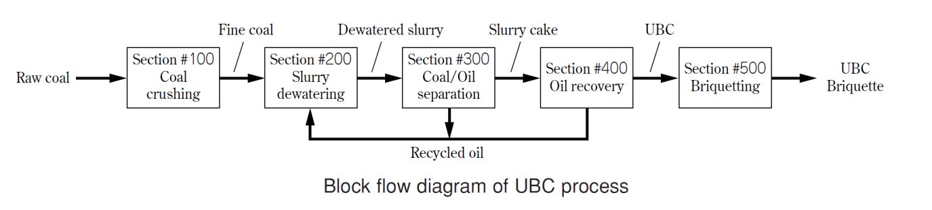
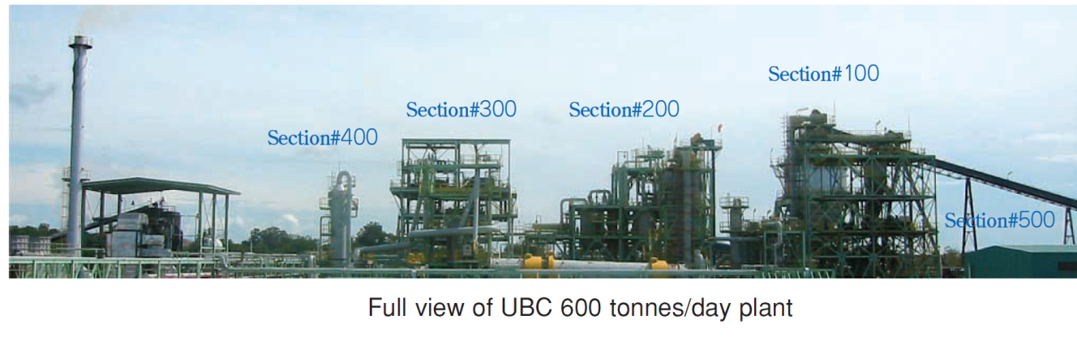
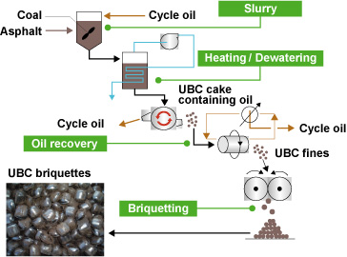
Kobe Steel – Upgraded Brown Coal (UBC) Process
Briquets are high calorific value, low ash coal content
Claimed to be compatible with coal fired power plants configured to run on bitumous coal

Slide 9
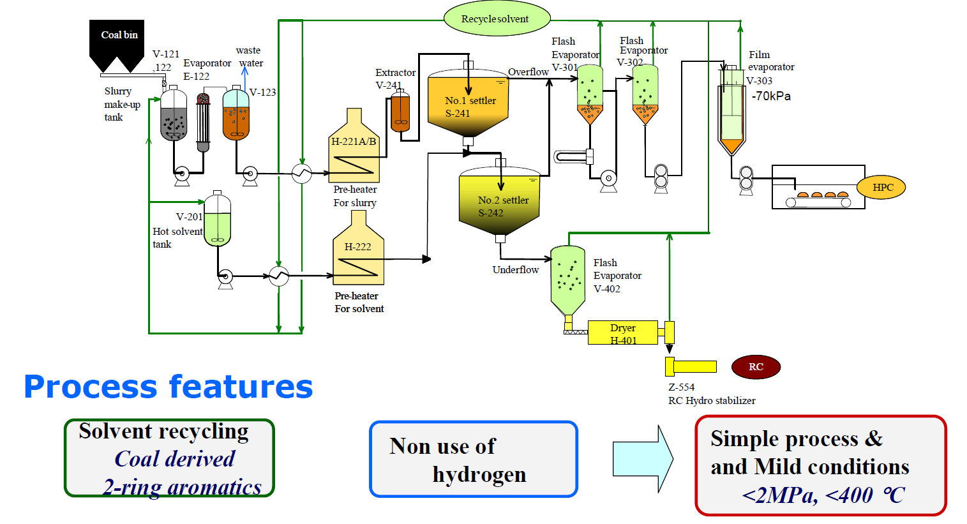
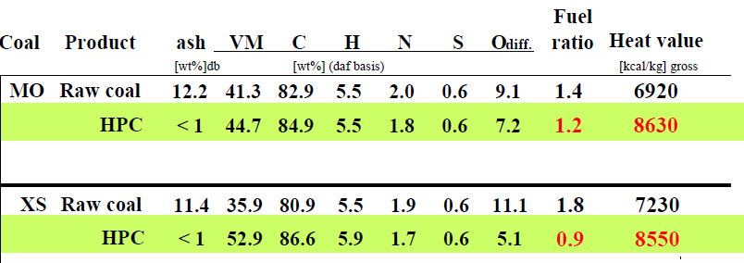
De-ashing Low Rank Coal - Hyper-Coal ™
Developed between 2001-2007
Turns low-grade thermal coal into coking coal (low ash)
Solvent extracts ash and insoluble at 380 deg C.
Ash and coal fines settle out during flotation
Proven to emulate coking coal in practice
Treatment cost is $100/mt !
Very coal quality dependent

Slide 10
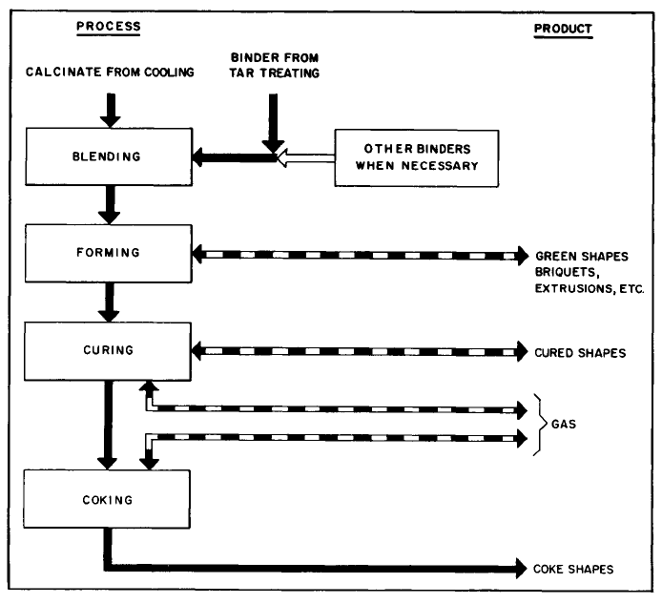
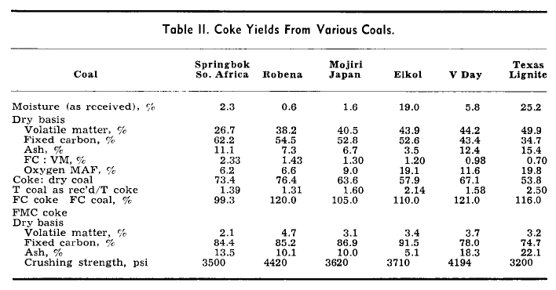
Transforming Wyoming Kemmerer Sub-bitumous coal into coke for steel making
The FMC Coke Process
Kemmerer Plant showing Calciner & Cooler
Upgraded sub-bitumous coal into coke
Operated 1980’s to 2002
Product shipped to USA steel industry
Plant shut down in 2002 due to tightening environmental requirements
  land contamination – phenols.
[Journal of Metals, May 1966]

Slide 11
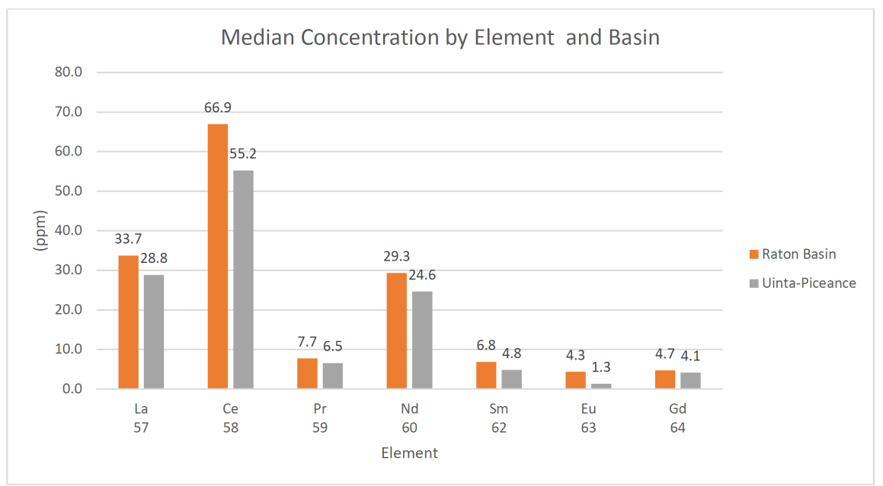
Evaluating Coal Conversion Approaches
  Considerations
  Even the inorganic mineral matter has value
    Coal homogeneity is crucial as it dictates processing methodology
      Construction Materials
      Source of very valuable rare earth elements
  Delibertate decomposition of coal including use of low temperature processes is key to extraction of value
  What if we combine solvent and thermal processing?
© 2017 All rights reserved. Property of the University of Wyoming
Notes:
There are two overarching ways to convert coal
Thermally
These methods are pyrolysis, gasification and liquefaction
They are also chemically converting coal as well, they just are at high temperature
Chemically
Solvent extraction
This is attractive because it is single phase and run at low temperatures
After considering our goals and constraints
Allows us to reject gasification and liquefaction
Instead, research solvent extraction and pyrolysis in NEW ways
Get new technology and processes that haven’t been done before

Slide 12
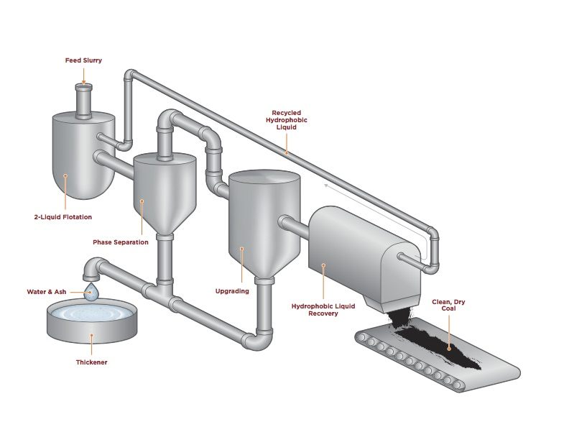
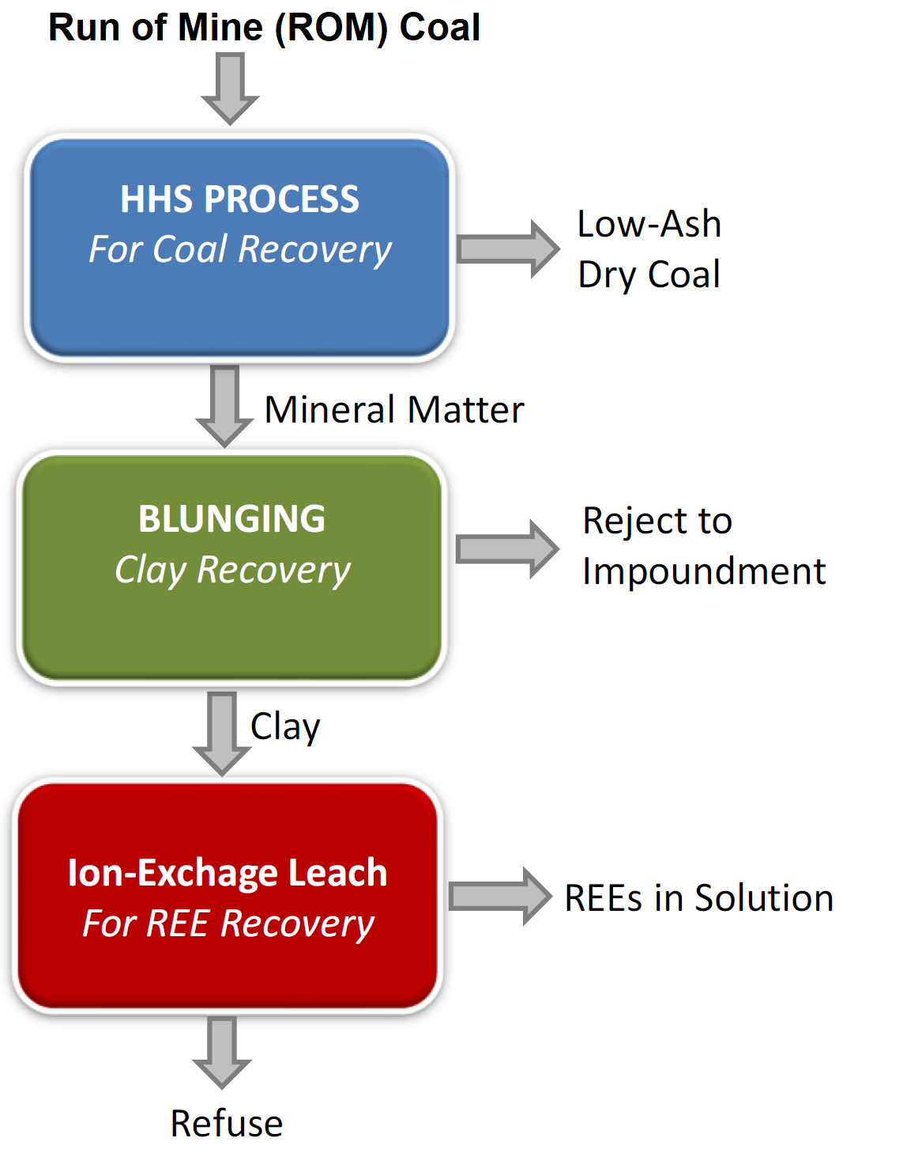
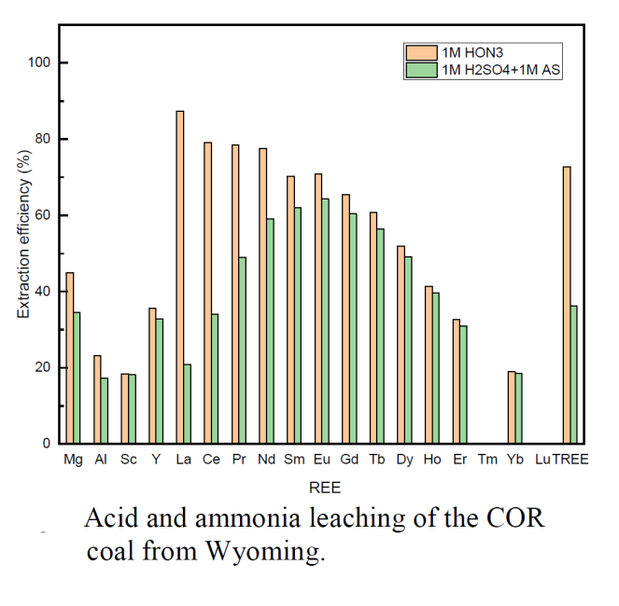
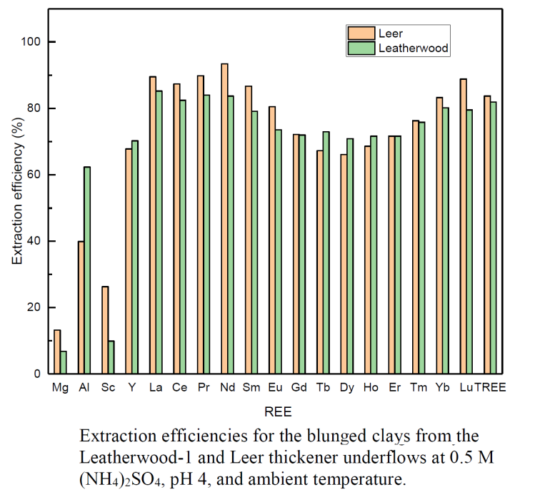
Thinking Synergistically
Extract & Recover Value from the Mineral Matter
Exploits hydrophilic and hydrophobic behavior of coal surfaces to dewater and recover moneral matter at low temeperatre
Solvent selection is critical and depends on coal minerology

Slide 13
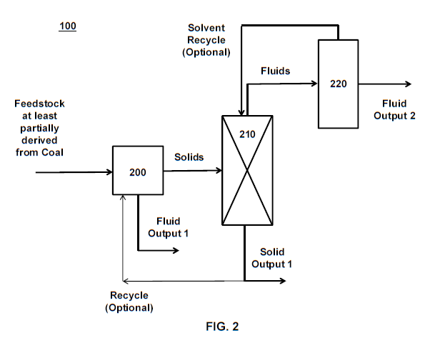
Coal Refinery - Platform Level Application
Thermo-Chemical Coal Processing
Systems and Methods for Refining Coal into High Value Products
  International App. No. PCT/US18/50690
  Filed September 12, 2018
  Published WO 2019/055529
  Foundational level patent application
    Combination of Solvent Extraction and Pyrolysis
    Highly-branched, purified product distribution
  Coordinated set of extension applications

Slide 14
Solvent Extraction Integrated
Example
2 stage extraction, dry methane reforming, phenol recovery, calcining, Carbidization
This is an example of how multiple technologies can be integrated into a multi-high volume product, low energy consumption & CO2 emissions complex
NH₃, S
CO₂
NatGas
Gas Clean-Up
Dry Methane
Reforming
Syngas
Gas
Flash Pyrolysis and fractionation
Light Density
Liquids
Phenol
Benzene. Toluene,
xylene
Hydrocarbon Solvent Extraction
Phenol Extraction
Medium Density
Liquids
Resins (Pitch, tars), fibers and surfactants
Coal
Heavy Density
Liquids
Asphaltenes (asphalts, fibers, cokes)
Metallurgical materials
Hi-Ash Char
Electrode materials
Low Ash Coke
Construction Materials
Soil Amendments
© 2017 All rights reserved. Property of the University of Wyoming
Notes:
Integrate technology to develop an early idea of a coal refinery
Talk through the flowsheet
Dry Methane Reforming is a way were handling the CO2 constraint.
We use systems engineering on each box individually as well as the overall process

Slide 15
Coal Refinery - IP Extensions
  Extension
  App. No. 1
  MODIFIERS FOR ASPHALT PETROLEUM PRODUCTS FROM COAL DERIVED LIQUIDS
  Extension
  App. No. 2
  GRAPHENE OXIDE USING MODIFIED HUMMER’S METHOD
  Platform Level
  Application
  Publication WO 2019/055529
  PCT/US18/50690
  Separate
  App.
  Dry methane Reforming Catalysts
  Separate
  App.
  Carbon Fiber
  Systems and Methods for Refining Coal into High Value Products
  Filed September 12, 2018
  Separate
  App.
  Green Building Materials
  Separate
  App.
  Silicon Carbide
  Extension
  App. No. 3
  THERMO-CHEMICAL PROCESSING OF COAL WITH 1-METHYLNAPHTHALENE
  Extension
  App. No. 4
  COAL(TAR) LIQUEFACTION BY ESTERIFICATION

Slide 16
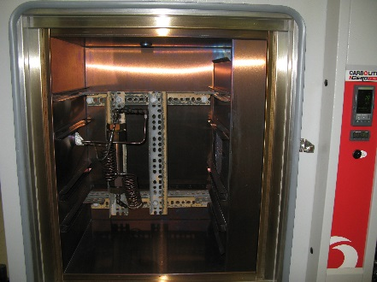
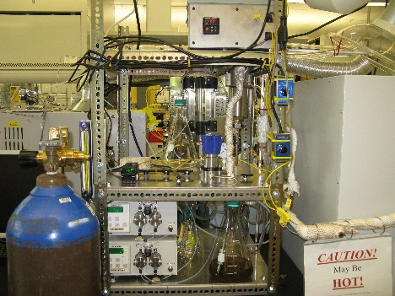
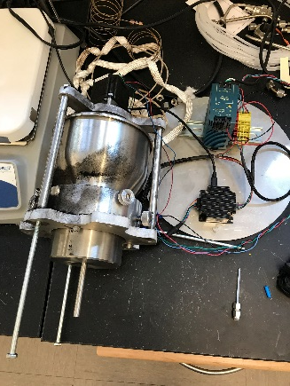

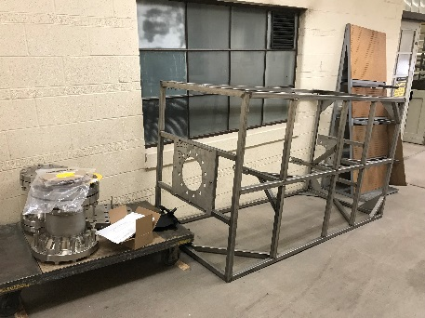
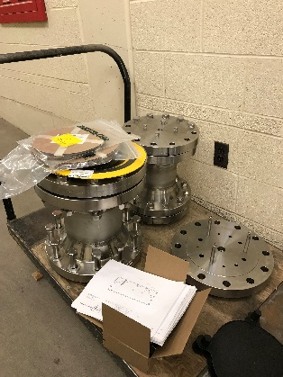
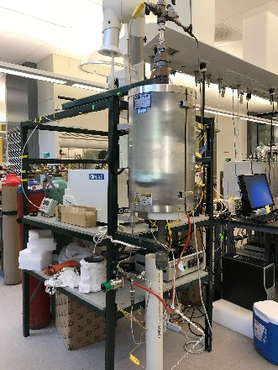
Thermo-chemical Processing to Deliberately Decompose Coal
Objectives
Develop a thermochemical pathway to deliberately decompose coal so that the liquid yield is maximized
Validate the performance on Wyoming coal
Identify the most attractive product types and pathways to pursue
Commercialize the thermo-chemical process as the backbone of a coal refinery
Coal residue liquid extraction
Pyrolysis
drop tube experiment
Continuous flow pyrolysis reactor
asphalt products projects
Next Milestones: By end 2019,
Commission continuous flow reactor and determine coal decomposition relationship with products and properties with a mass balance. Design and construct process pilot plant based upon these findings.
[ Ref: Bell Research Group, Department of Chemical Engineering, University of Wyoming]

Slide 17
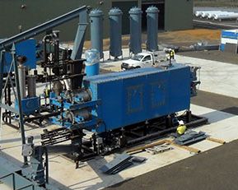
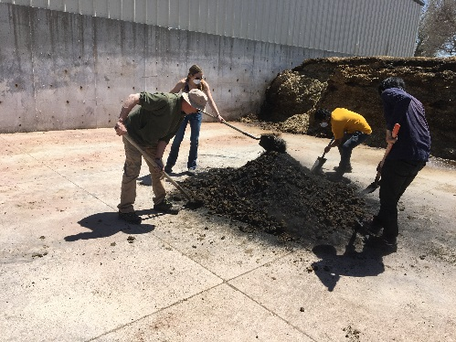

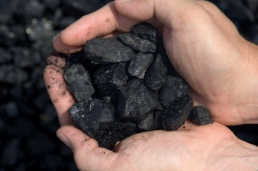
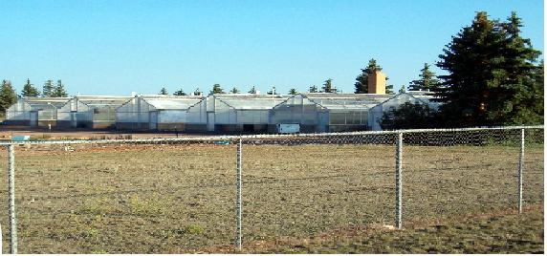
Improve Soil Fertility in Wyoming
Objectives
Confirm that coal derived organic-chars can improve soil condition for growing crops
Understand crop growth relationship between (short term) nutrient additives & (long term) soil structure change
Synthesize coal based coal derived soil fertility improvement products using pyrolysis approaches
Validate performance of soil fertility product formulas in the field (on wheat and corn).
Soil Fertility Demonstration: May 2018
Wyoming
PRB Coal
Coal -Pyrolysis
Greenhouse Studies
Coal derived organic char mixing with nutrient
[ Ref: Stahl Research Group, Department of Ecosystem Science and Management, University of Wyoming]

Slide 19
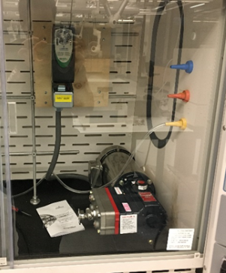
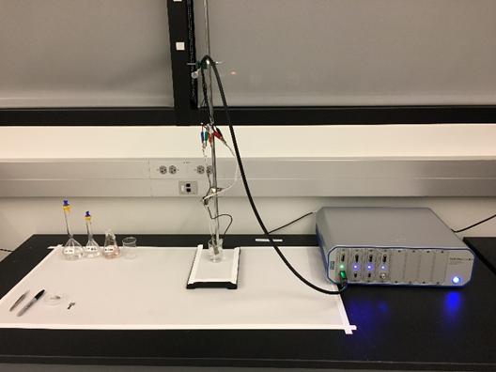
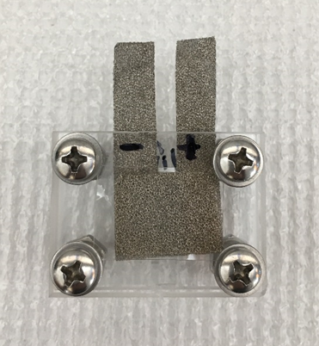
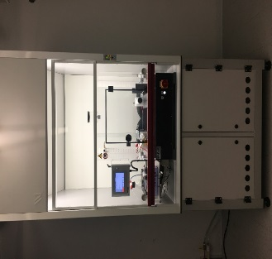
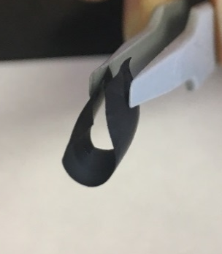
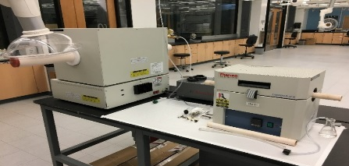
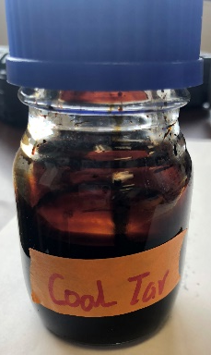
Manufacture of Carbon Fiber Mats
from coal derived precursors for electrical and thermal applications
Objectives
Derive & characterize coal tar and solid coal extracts to make fiber mats for electrical duties
Understand the relationship between chemistry and product performance
Make fiber mats with superior electrical performance
Validate application of products in energy storage applications
Solvent Recovery
Capacitance Characterization
Wyoming
PRB Coal
Heat-treatment
Electro-spinning
Elastic coal-based
carbon fiber mat
High Performance
Supercapacitor
Coal (solvent extracted)
liquid Extract
[ Ref: Li Research Group, Department of Chemical Engineering, University of Wyoming]

Slide 20
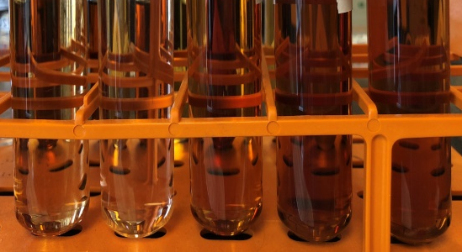
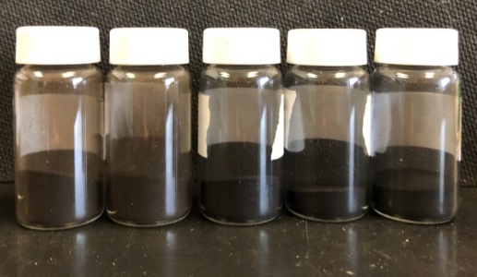
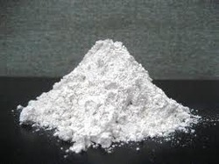
Green Building Materials from Wyoming Coal
Objectives
Develop green building material formulations for coal derived intermediate products
Evaluate performance of coal based materials against building product specifications
Identify performance improvement additives and chemistry changes
Perform field trials
Coal derived ‘Green’ Building
Products
Wyoming
PRB Coal
Heat-treatment (~500 deg. C)
CER-500
CER-600
CER-700
CER-800
CER-900
CER-500
CER-600
CER-700
CER-800
CER-900
Coal extracts (solvent)
Calcination
carbon fiber reinforced geopolymer,
geopolymer bricks,
coal ash foam glass,
(d) coal ash silica aerogel
wall plaster
[ Ref: Tan Research Group, Department of Civil & Architectural Engineering, University of Wyoming]

Slide 21
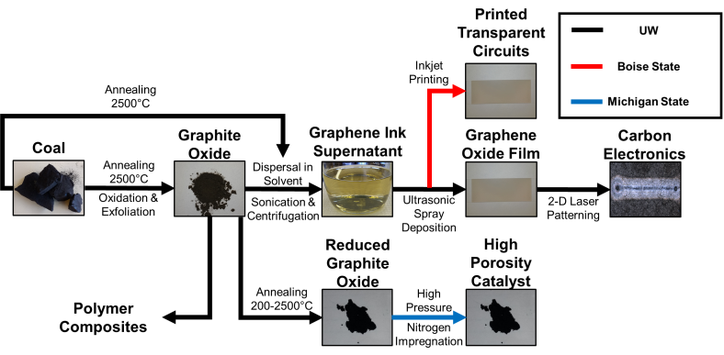
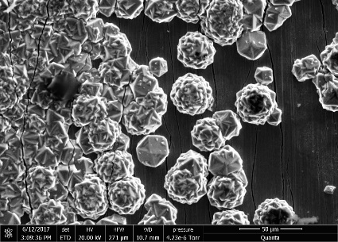
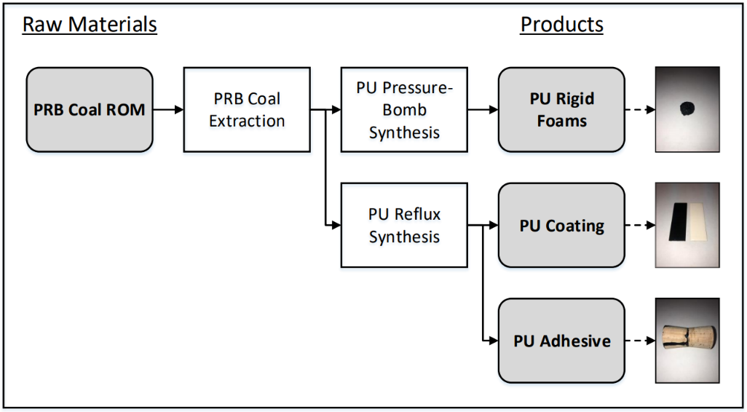
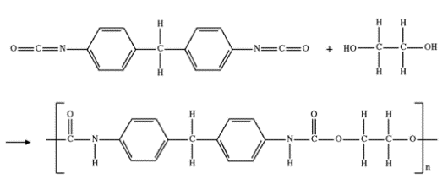
Manufacture of High-performance composite-resin systems and coatings from coal
Objectives
Derive high temperature resin systems from coal extracts
Extract and transform coal solid-derivatives into performance enhancing additives
Design and validate coal derived composite material solutions
Validate application of products in extended performance product duties
Diamond films
produced directly from coal
Wyoming
PRB Coal
Graphitic Products
Polyurethane resin systems
[ Ref: Johnson Research Group, Department of Chemical engineering, University of Wyoming]

Slide 22
Concluding Remarks
  Indian coal has unique properties which need to be fully understood if the hiden value is to be realized.
  Significant growth opportunities exist to use cioal as a feestock to make engineered products
    Even the recovered mineral matter has value
  Deliberate decomposition coal rather than destruction using high temperature has proven to be a viable solution to transform coal into value added products
    Application of thermo-chemical processing still to be proven on coals other than Wyoming Powder river basin (PRB) coal
© 2017 All rights reserved. Property of the University of Wyoming
Notes:
There are two overarching ways to convert coal
Thermally
These methods are pyrolysis, gasification and liquefaction
They are also chemically converting coal as well, they just are at high temperature
Chemically
Solvent extraction
This is attractive because it is single phase and run at low temperatures
After considering our goals and constraints
Allows us to reject gasification and liquefaction
Instead, research solvent extraction and pyrolysis in NEW ways
Get new technology and processes that haven’t been done before

Slide 23
Thank You
© 2017 All rights reserved. Property of the University of Wyoming

